Slide 1



RAPHAEL
SMART PATIENT RECORD TRACKING VIA BLOCKCHAIN AND HOSPITAL STAY PREDICTION
Inderdeep Singh
Abhishek Pathak
Karan Singh
Mudit Sharma
TEAM NAME : 404
TEAM ID : 053

Slide 2
PROBLEM STATEMENT
The lack of patient medical background history that creates problem for MEDICAL INSURANCE COMPANIES / DOCTORS to take actions and provide delay in emergency cases
So there is a lack of reliable, fast and secure Patient Information System that keeps records of all patient and helps in Bed management by providing the correct information
A serious drawback of Indian Health services is the shortage of beds due to which hospitals face the problem of crowding, waiting times, lack of resources and cost containment
Also to prevent hospitals from charging extra money for staying there

Slide 3
ENTITIES impacted by Product
PATIENT
In-patient fraud detection
HOSPITAL MANAGEMENT
Low crowd
Bed scheduling
INSURANCE COMPANIES
Client history
Reliable records
DOCTORS
Patient records history
Helps in emergency
Reliable and secure reports
Cost containment
Better efficiency
Profit Increase
Fraud Detection
Trust
Transparency
Customer tracking
Market strategy

Slide 4
(WHAT) DOES (WHAT) FOR (WHOM) ?
Raphael does authentication of Claim , market strategy , profit and monitoring for Insurance companies
Raphael does smart record keeping for patients

Slide 5
BLOCKCHAIN
ARTIFICIaL INTELLIGENCE
Secure by SHA-256
Distributed
Decentralized
Reliable
Immutable
IBM Watson data research - 10,000
RFC and Naive Bayes model
Genetic Algorithm
Data Analysis

Slide 6
CURRENT MODEL
WORKING
BLOCK CREATION - API
BLOCK MINING - API
STAY PREDICTION – API
FLASK SERVER
BASIC FRONT END
SHOWS FUNCTIONALITY AND INTEGRATION
PARTIAL CODES
BED MANGEMENT ANALYSIS
GENETIC ALGORITHM
NOTIFICATION SYSTEM

Slide 7
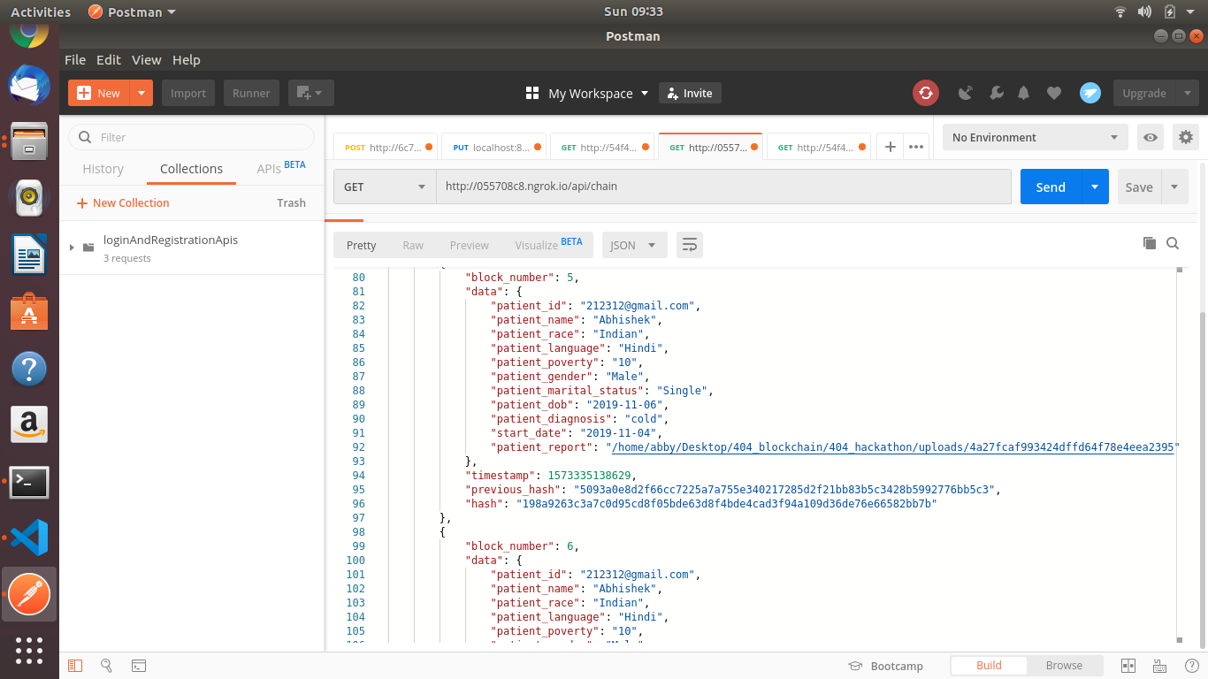

Slide 8
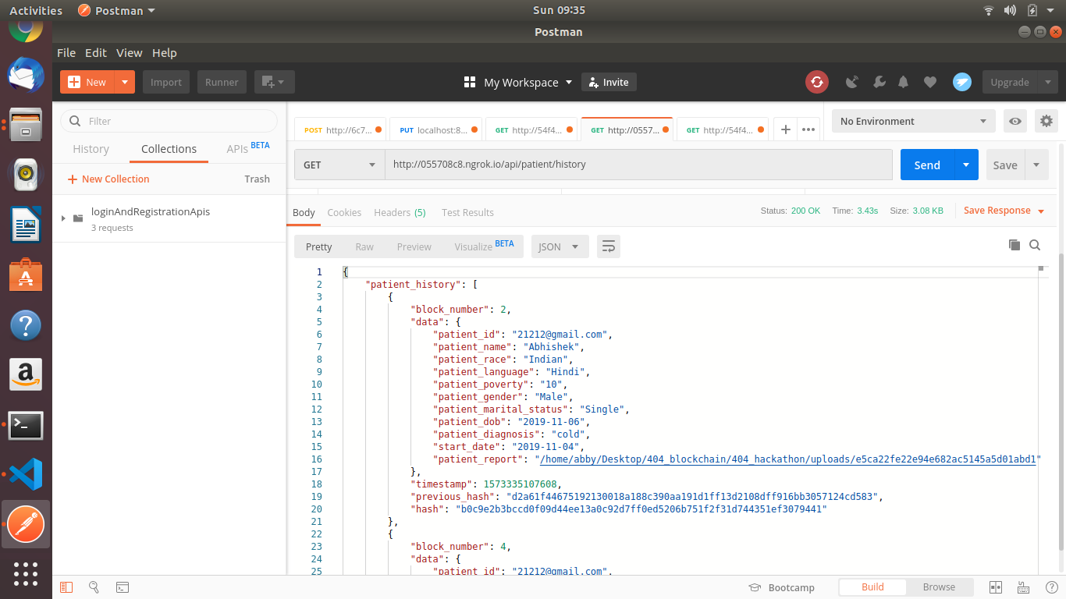

Slide 9
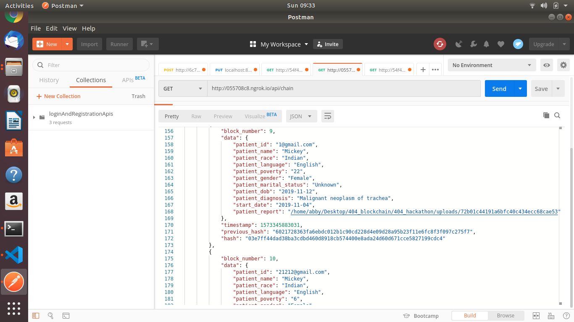

Slide 10
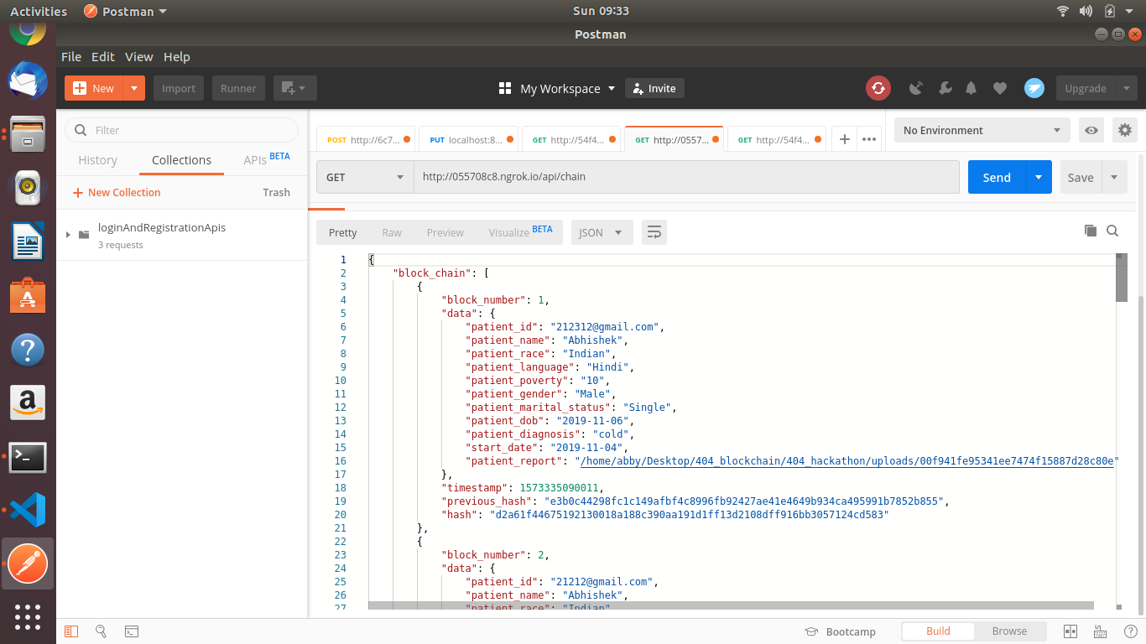

Slide 11
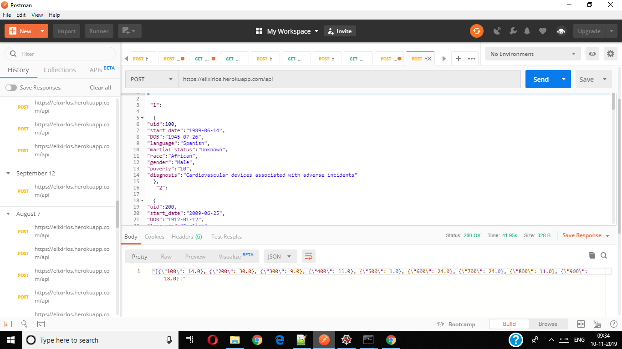

Slide 12
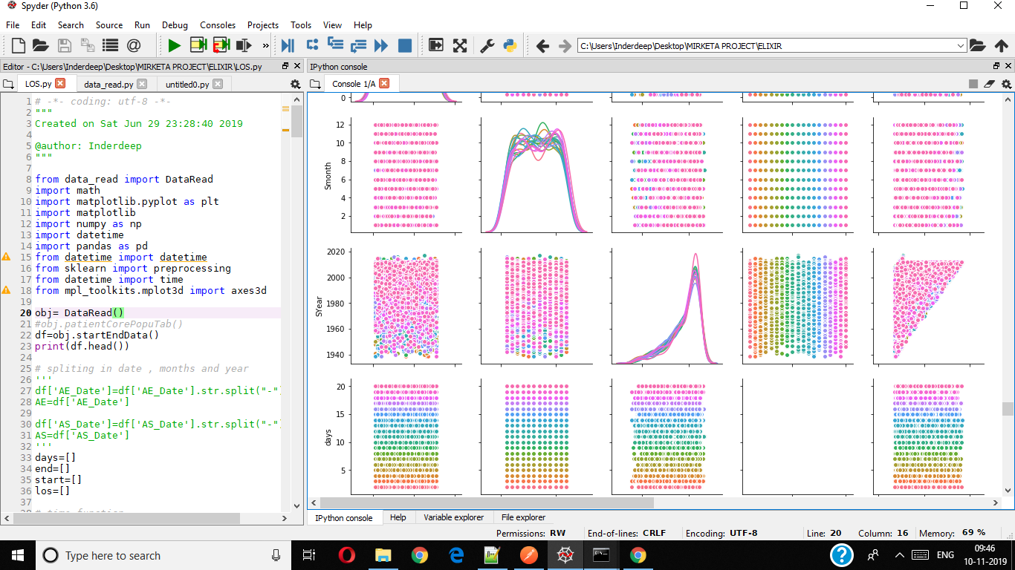

Slide 13
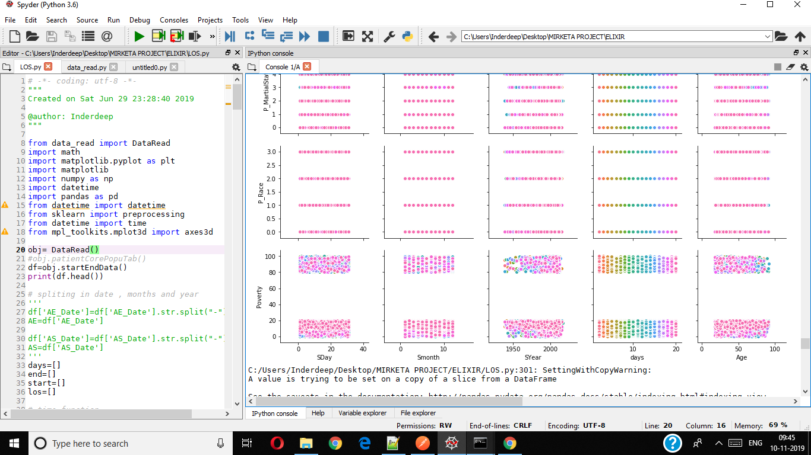

Slide 14
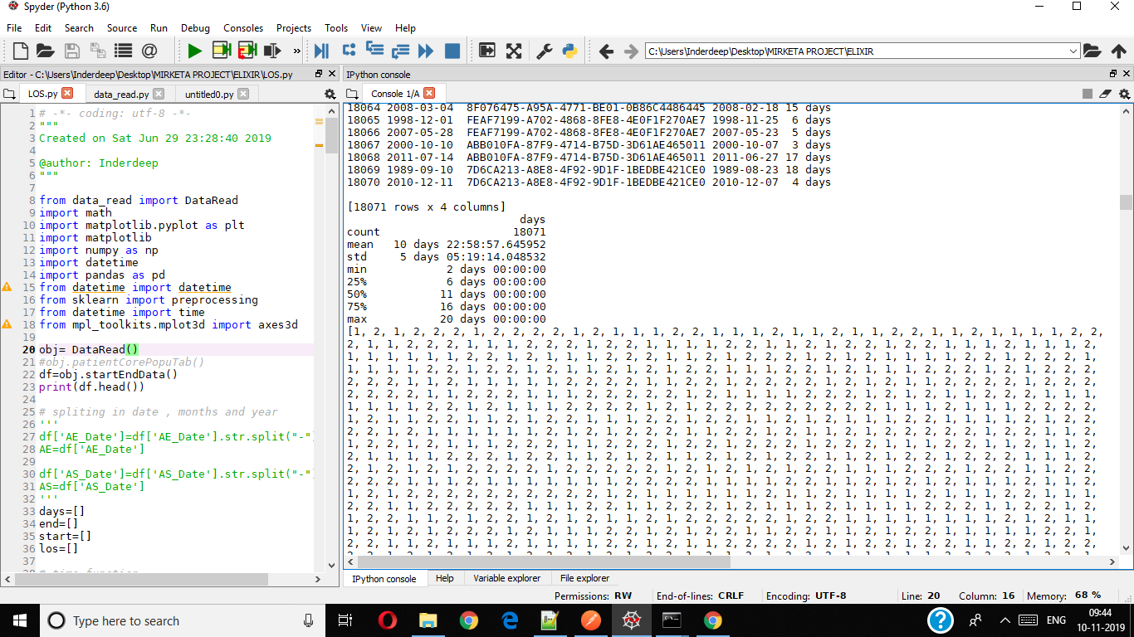

Slide 15
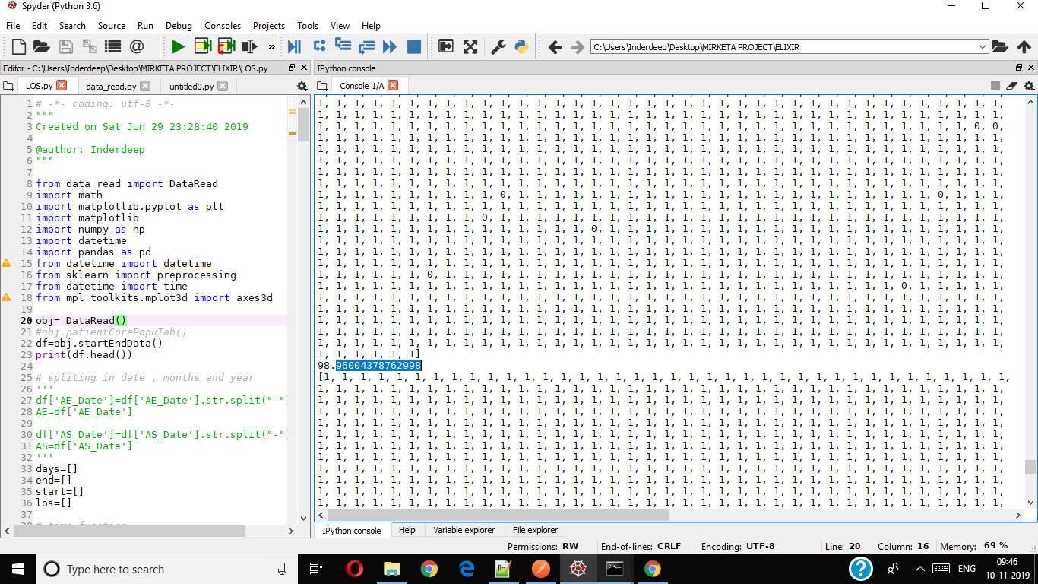

Slide 16
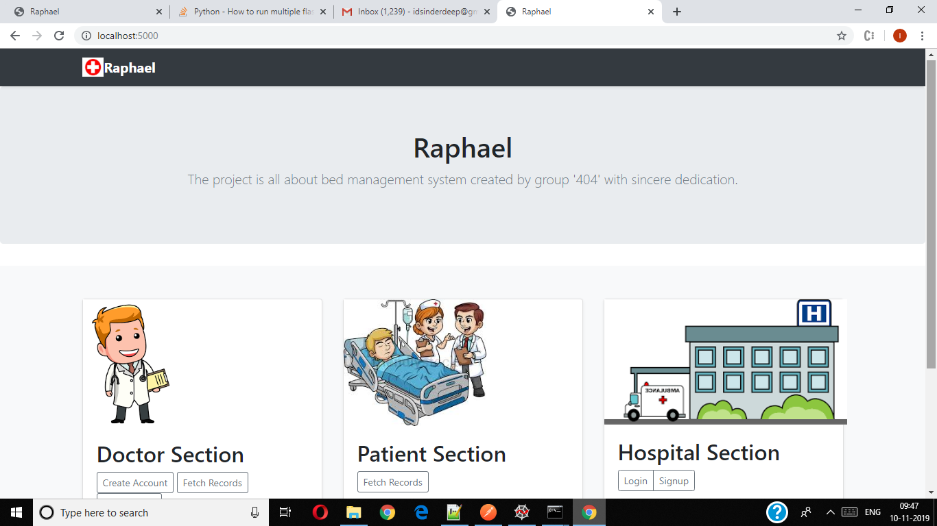

Slide 17
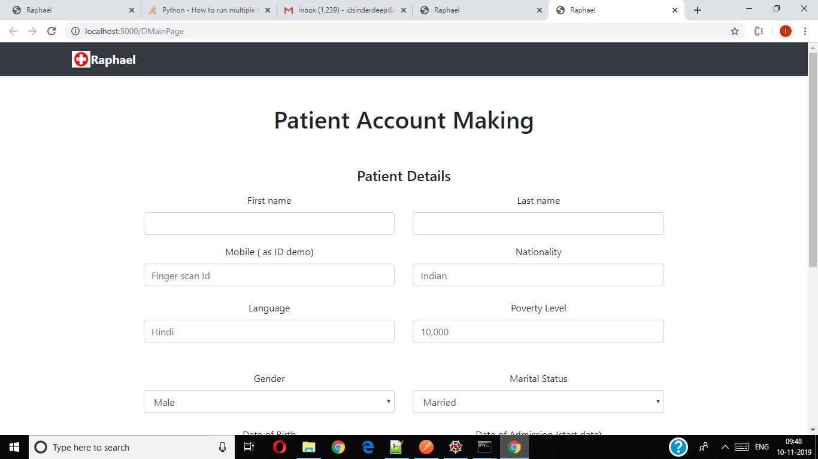

Slide 18
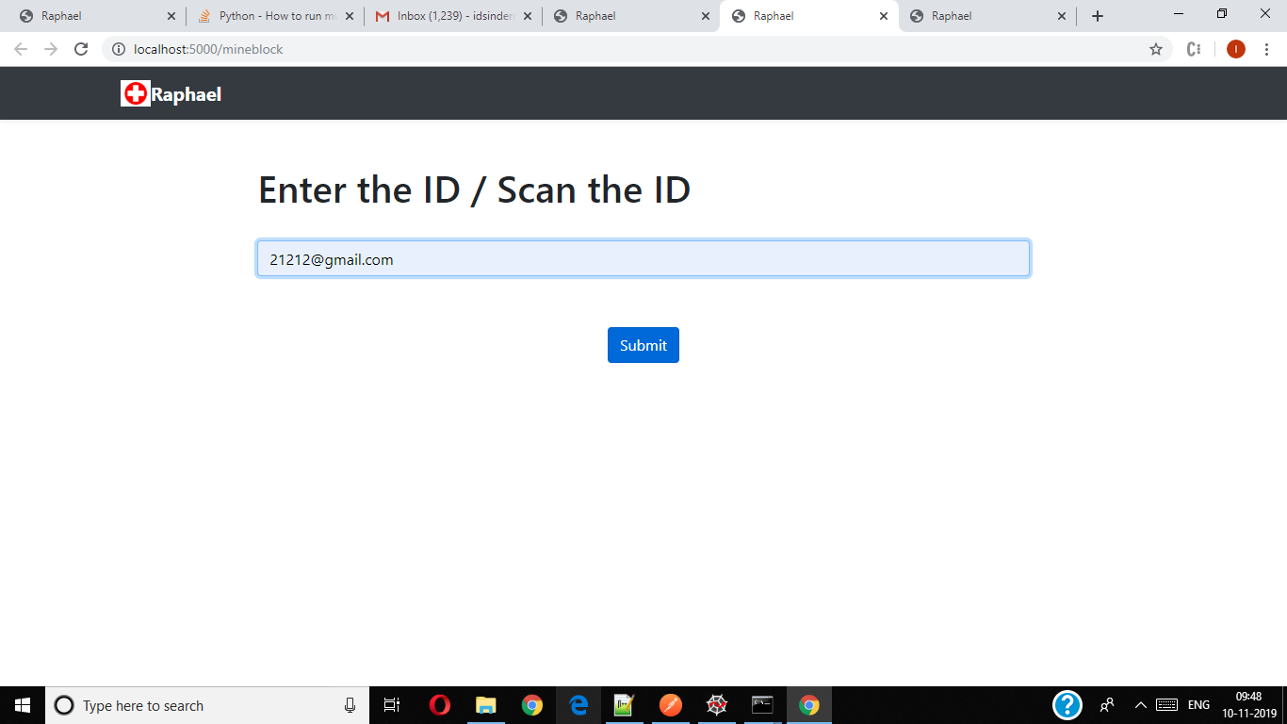

Slide 19
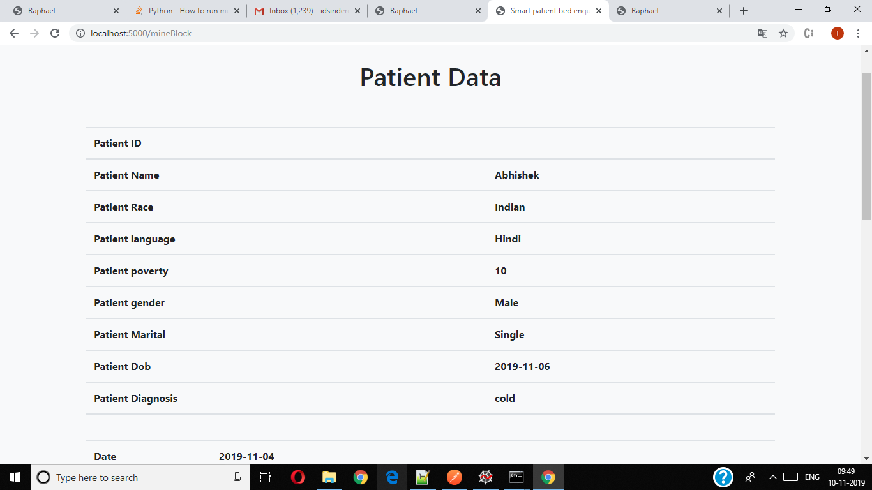

Slide 20
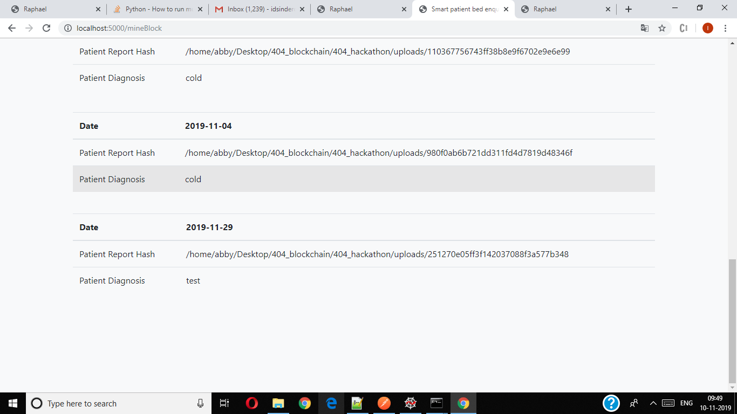

Slide 21
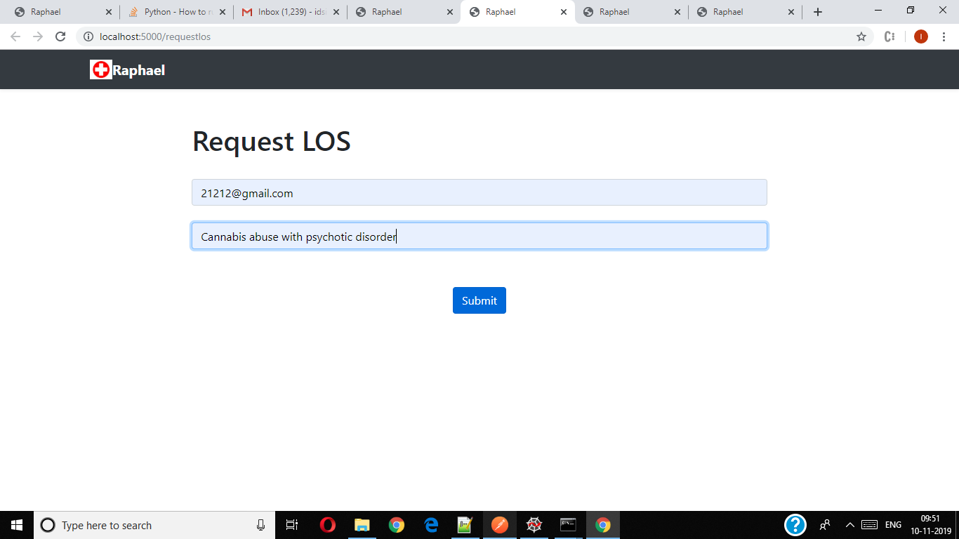

Slide 22
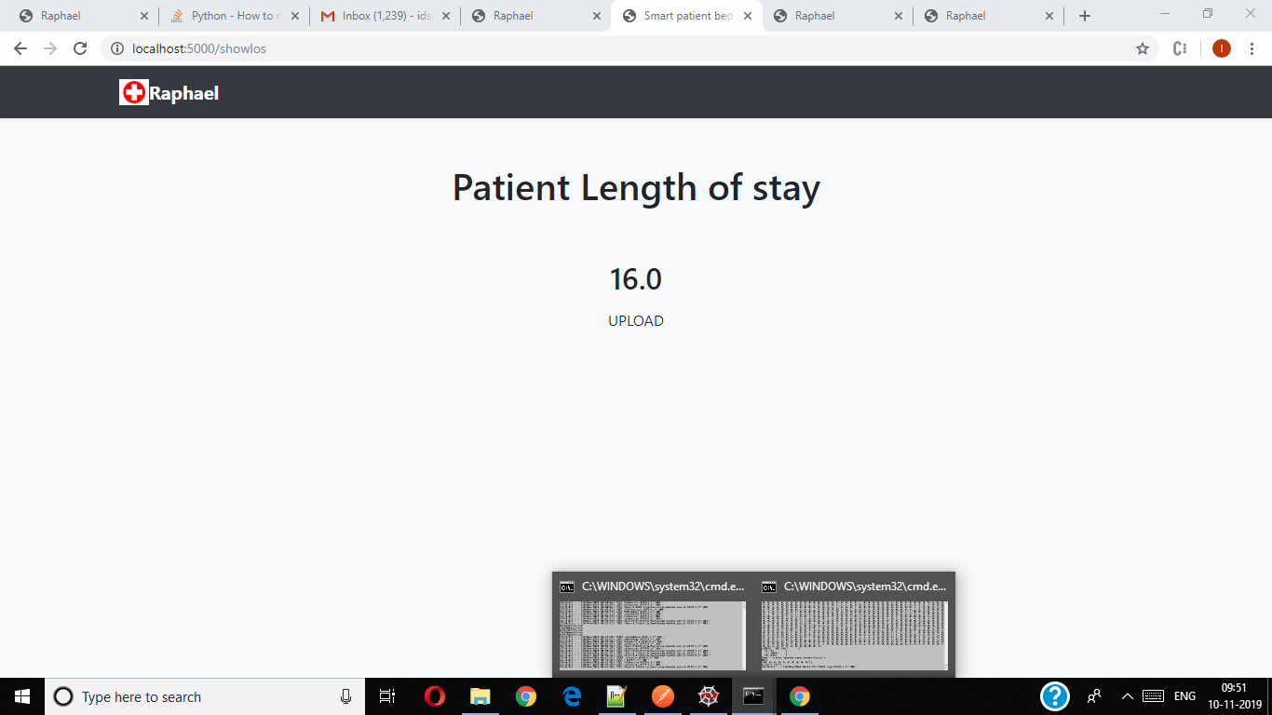

Slide 23
Thank You

